Slide 1

Human Genomics Analysis Interface
(U01-DE024425)
Mary L. Marazita
Eleanor Feingold, Harry Hochheiser, Elizabeth J. Leslie,
University of Pittsburgh
Center for Craniofacial and Dental Genetics
FaceBase Annual Meeting
May 15-16, 2018

Slide 2
ACKNOWLEDGEMENTS
Staff/Students:
Nandita Mukhopadhyay
Myoungkeun Lee
Annette Krag-Jensen
Lance Kennelty
Tamra Mitchell
Tom Maher
Jim Gallagher
Justin Stickel
Jenna Carlson
Funding NIDCR
U01-DE024425
Faculty:
Mary L. Marazita
Eleanor Feingold
Harry Hochheiser
Elizabeth Leslie

Slide 3
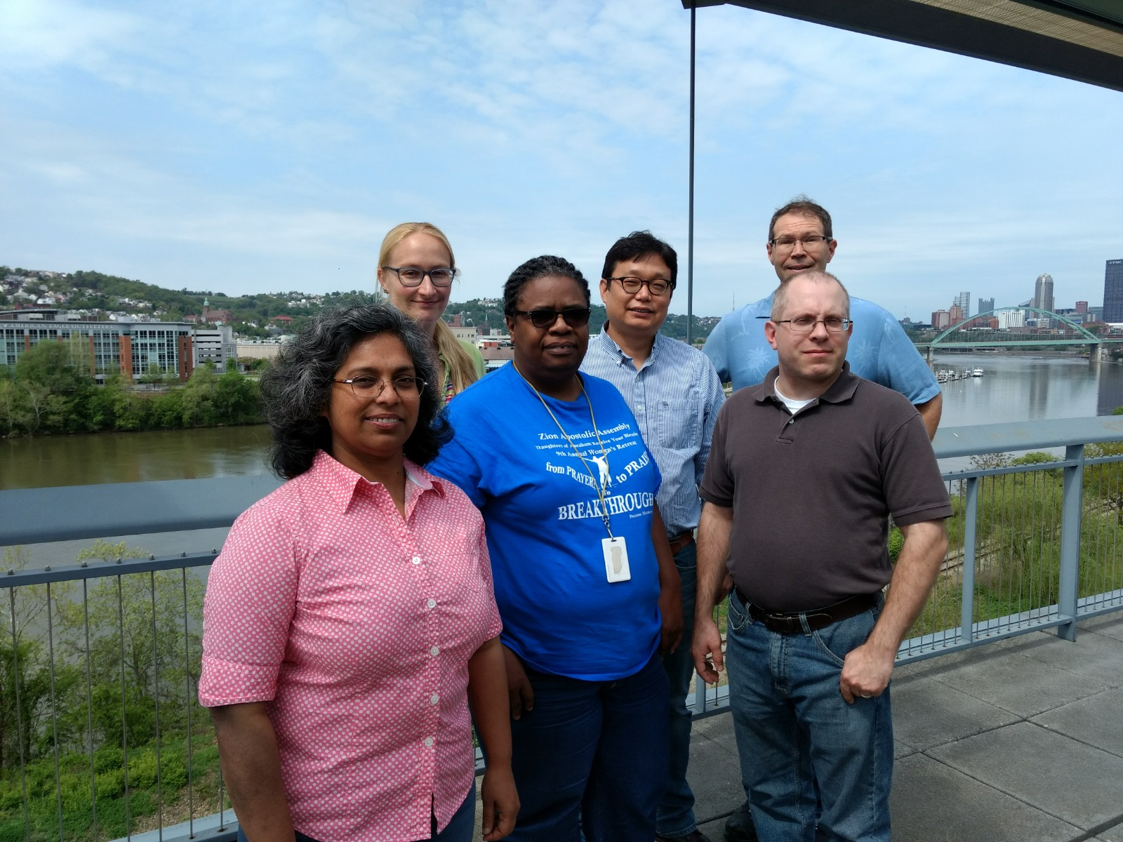
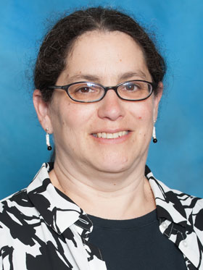





Slide 4

GOALS
Develop software interface for Human Genomics Results
  No access to individual level data
  Secure hardware
Identify appropriate craniofacial and oral genomics projects
  From research community, dbGaP, publications
Create and display results from genomics projects
  E.g. Manhattan plots, LocusZoom

Slide 5
APPROACH
User friendly, save user time
Pre-calculate results databases (e.g. p-values at SNPs)
  For all relevant subsets: by ethnicity, by genotyped versus imputed panels, by phenotype, by environmental factors
  Customized: with input from PIs (e.g. published results)
Manhattan plots
LocusZoom interface for specific SNP/gene/region requests

Slide 6
UPDATES
Past version:
  Static Manhattan and LousZoom plots
User requests---
Added Interactive Manhattan and LocusZoom plots

Slide 7

WEBSITE
http://FaceBase.sdmgenetics.pitt.edu
Link available through FaceBase.org, see our FaceBase Project page

Slide 8
Plans for Year 5
Continue to optimize the web site
Add a few more databases
Work with the Hub
  Move site to the Hub
  Provide documentation on how to add new data

Slide 9
ACKNOWLEDGEMENTS
Staff/Students:
Nandita Mukhopadhyay
Myoungkeun Lee
Annette Krag-Jensen
Lance Kennelty
Tamra Mitchell
Tom Maher
Jim Gallagher
Justin Stickel
Jenna Carlson
Funding NIDCR
U01-DE024425
Faculty:
Mary L. Marazita
Eleanor Feingold
Harry Hochheiser
Elizabeth Leslie

